Slide 1
The Skeletal System || Human Skeleton || Class 5 || Science - смотреть онлайн в поиске Яндекса по Видео (yandex.ru)
Skeleton

Slide 2
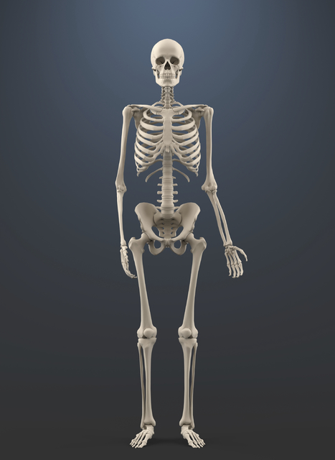
The Skeleton is composed of bones. In the adult the skeleton has over 200 bones.
It performs several functions :
Supporting
Protectve
Locomotor
Formative

Slide 3
Skeleton
Axial skeleton
Appendicular skeleton
Spine
Skull
Thorax
Upper limbs bones
Lower limbs bones

Slide 4
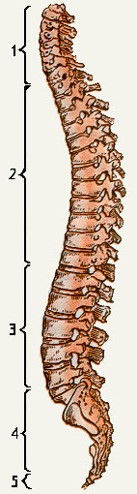
The Spine is composed of 33 seperate vertebrae:
7 cervical vertebrae
12 thoracic vertebrae
5 lumbar vertebrae
5 sacral vertebrae
1-5 coccyx
( * The vertebra is a small bone which is formed by the body and the arch)

Slide 5
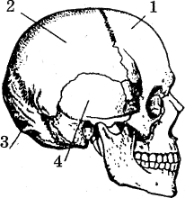
Skull has two departments:
- back skull
- facial skull
Skull bones:
Frontal
Parietal
Occipital
Temporal

Slide 6
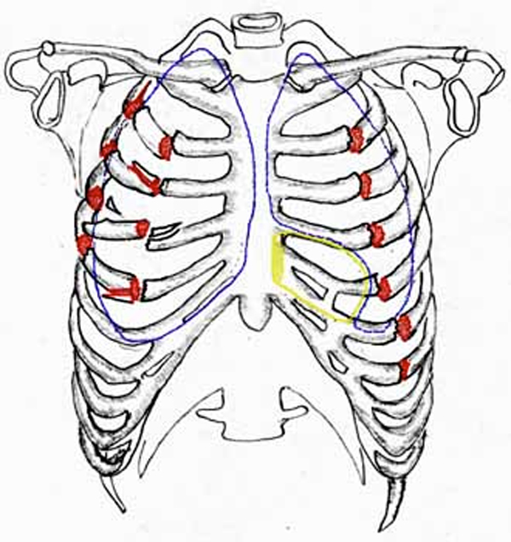
Thorax is supported by the spine.
It is composed of 12 thoracic vertebrae, the breastbone, and 12 pairs of ribs.
The breastbone is a long bone in the middle of the chest.
Each rib consists of a head, neck and body.

Slide 7
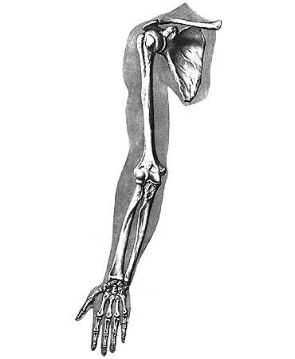
Upper limbs are formed by:
Clavicle
Scapula
Ulna bone
Radius bone
Phalanges

Slide 8
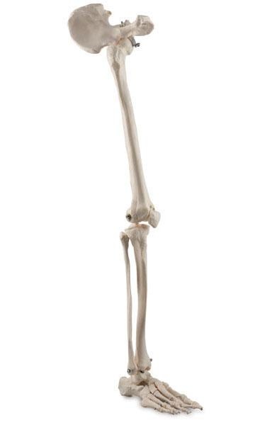
Lower limbs are composed of:
Femur
Fibula
Tibia
Phalanges

Slide 9
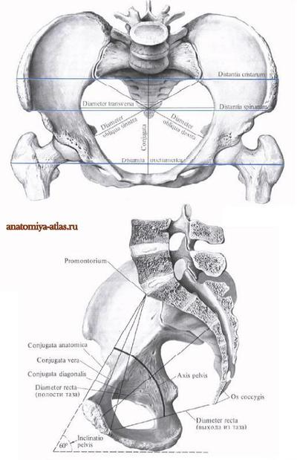
Pelvis connects lower limbs with the trunk.
Bones of the trunk are connected together by joints, cartilages and ligaments.
The bones consist of organic and inorganic substance.

Slide 10
Latin Terminology versus English Terminology
sceletum /sceleton skeleton
thorax thorax
cervicalis cervical
thoracalis thoratic
sacralis sacral
coccyx coccyx
frontalis frontal
temporalis temporal
occipitalis occipital
parietalis parietal

Slide 11
Literature:
1.Козырева Л.Г. , Шадская Т.В. Английский язык для медицинских колледжей и училищ. Учебное пособие- Ростов Н. Д. изд-во «Феникс» 2002
2. Мюллер В.К., Дашевская В.Л.,Каплан В.А. Новоый англо-русский словарь.- 8-е издание.- М: Рус.яз.,2011.- 880с.
3.Сапин М. Р. Анатомия человека:
Учебное для студентов высшего учебного заведения: В 2 кн., 2003.
М: ООО Издательство « Мир и образование»
4.Тылкина С.А. Темчина Н.А. Пособие по английскому языку для медицинских училищ М:АНМИ. 1998.

Slide 12
THANKS FOR ATTENTION.

