Slide 1
The Olympic Games
выполняла: Ядрышникова Надежда
студентка 121 группы

Slide 2
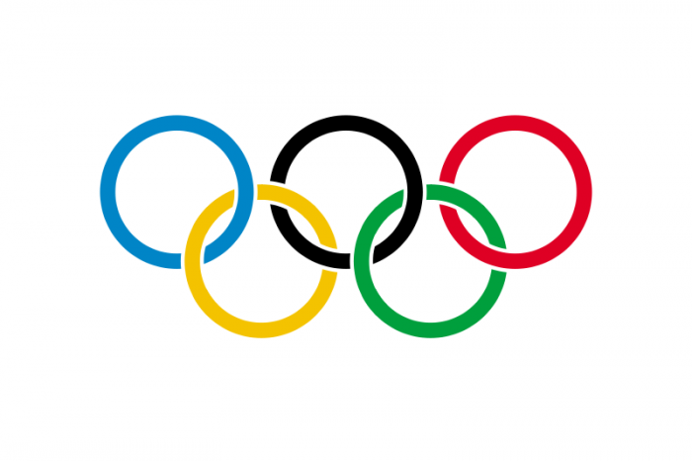
The tradition of the Olympic Games, which existed in ancient Greece, was born as part of a religious cult. Games were held from 776 BC at 393 BC (A total of 293 Olympic Games) in Olympia, the Greeks regarded as a sacred place. Olympia was the name of the Games.

Slide 3
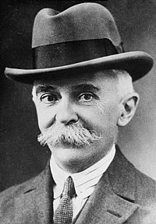
The modern Olympic Games were revived in the late XIX century French philanthropist Pierre de Coubertin. Olympic Games, also known as the Summer Olympic Games, held every four years since 1896, except for years, came to the world wars.

Slide 4
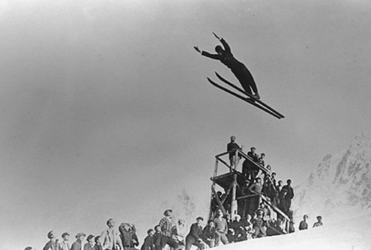
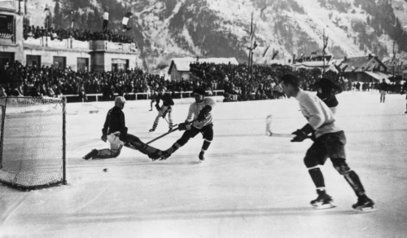
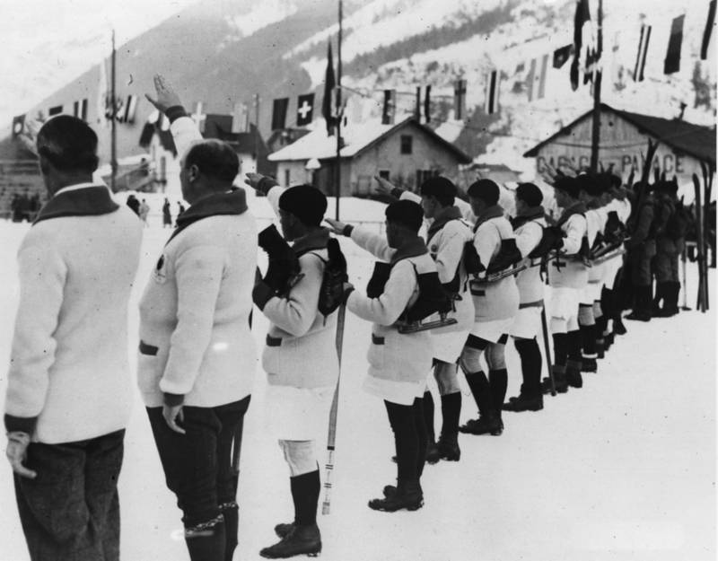
In 1924 were instituted the Olympic Winter Games, which were originally held in the same year as the Summer. However, since 1994, the time of the Winter Olympics shifted by two years with respect to the time of the Summer Games.

Slide 5
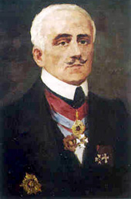
The revival of the Olympic Games
The first real precursors of the modern Olympic Games are "Olympia» enru, which are held regularly during the 1859-1888 period. The idea of reviving the Olympic Games in Greece belonged to the poet Panagiotis Sutsosu, embodied in her life public figure Evangelis Zappas.

Slide 6
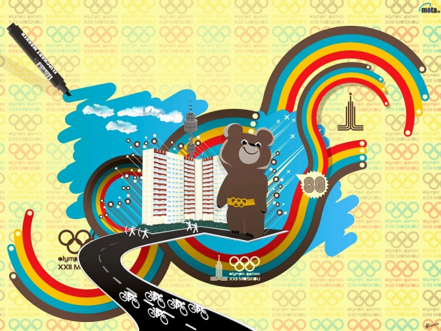
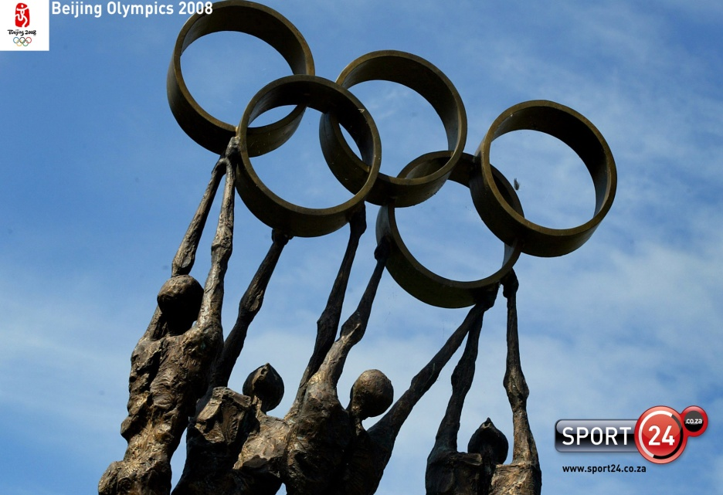
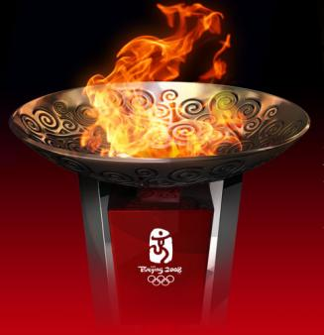
Modern Olympic Games
Olympics Games, also known as the Summer Olympics, held in the first year of 4-year-old (Olympic) cycle. Score Olympiads conducted since 1896, when the first Olympic Games (I Olympiad - 1896-99). Olympics gets his number and when the game is not carried out (eg, VI - in 1916-19, XII-1940-43, XIII - 1944-47).

Slide 7
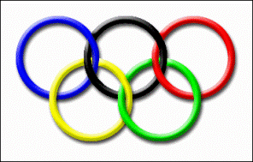
The symbol of the Olympic Games - the Olympic rings, the five fastened rings symbolizing the union of the five parts of the world in the Olympic movement. Color rings in the top row - blue, black and red. In the bottom row - yellow and green. The Olympic Movement has its own emblem and flag approved by the IOC at the suggestion of Coubertin in 1913. The logo - the Olympic rings.

