Slide 1
Shadrinsk Medical College
Great Britain

Slide 2
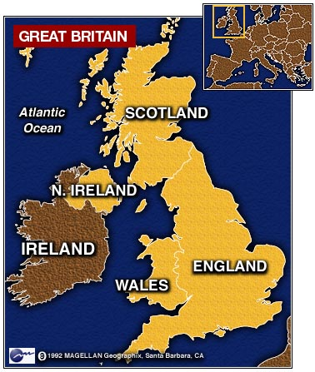
Great Britain consist of four countries

Slide 3
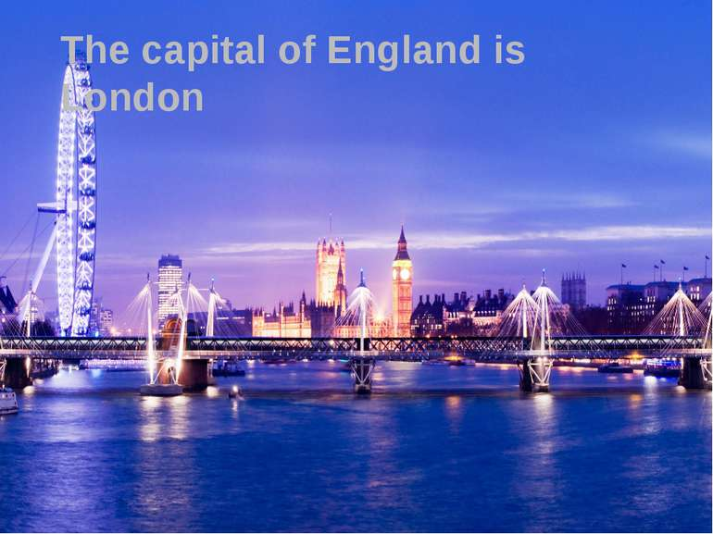

Slide 4
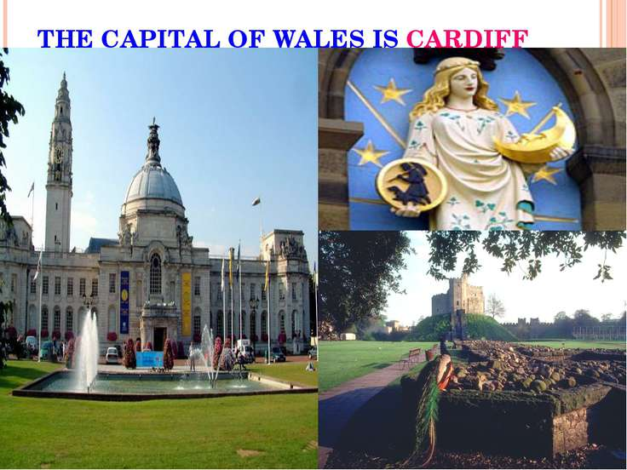

Slide 5
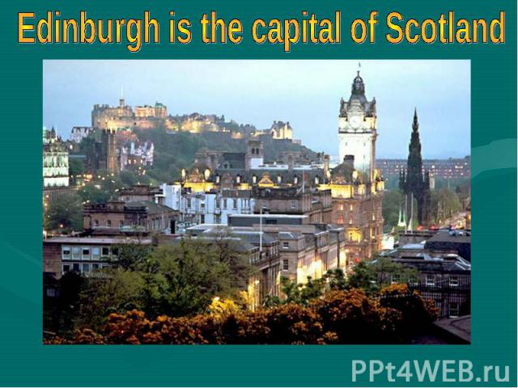

Slide 6
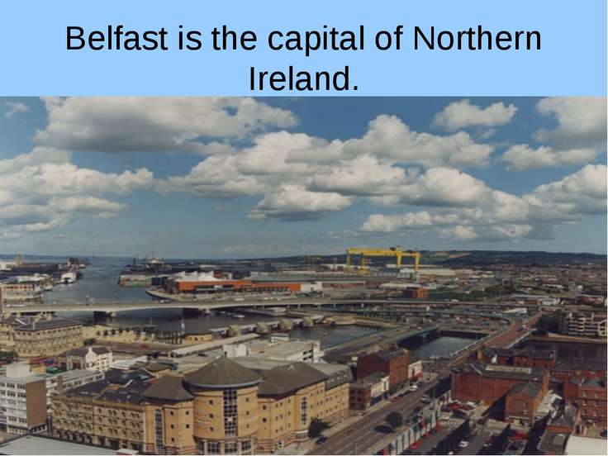

Slide 7
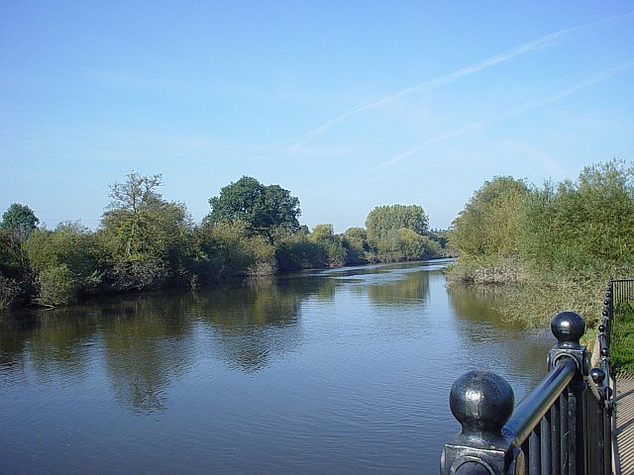
the Severn longest river in Britain.

Slide 8
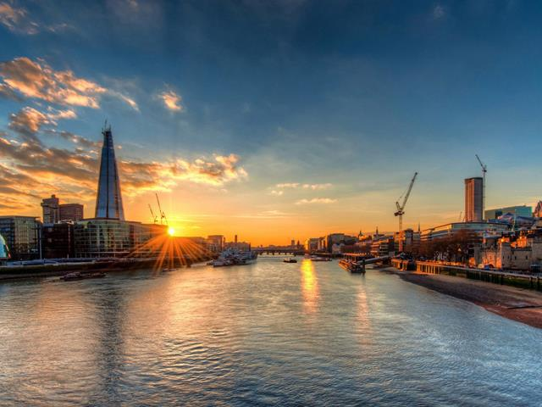
Thames River

Slide 9
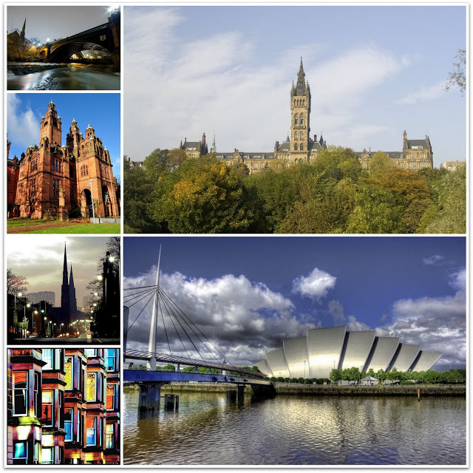
The largest cities of Great Britain are London,Birmingham,Liverpool,Manchester,Sheffield,Glasgow,Cardiff and Belfast

Slide 10
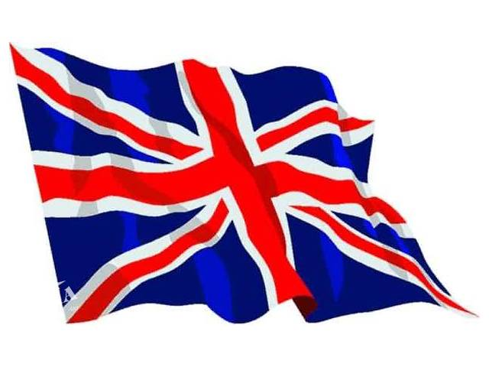
UK Flag

